Slide 1

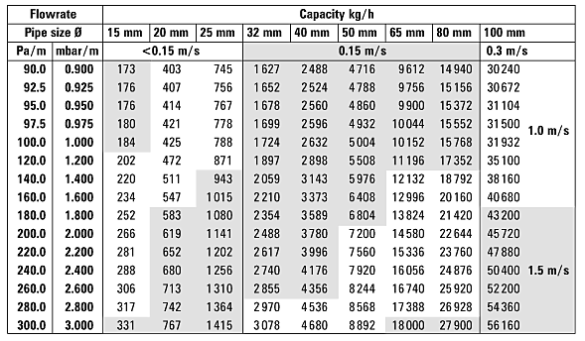
PREDICTING EMPLOYEE ATTRITION USING MACHINE LEARNING
P. D. Sai Vardhan | A. Sai Kaushik | Balagopal. T. S | Dr. Sairabanu J | SCOPE
Introduction
Results
Employee attrition is the loss of employees due to personal reasons, low job satisfaction, low salary, and/or a bad business environment. Aim of our project is to develop a software that predicts employee attrition using various parameters utilizing various machine learning algorithms and also compare the results.
Importing / inserting files…
Images such as photographs, graphs, diagrams, logos, etc., can be added to the poster.
To insert scanned images into your poster, go through the menus as follows: Insert / Picture / From File… then find the file on your computer, select it, and press OK.
The best type of image files to insert are JPEG or TIFF, JPEG is the preferred format.
Be aware of the image size you are importing. The average colour photo (13 x 18cm at 180dpi) would be about 3Mb (1Mb for B/W greyscale).
Do not use images from the web ass they will print very poorly.
Notes about graphs…
For simple graphs use MS Excel, or do the graph directly in PowerPoint.
Graphs done in a scientific graphing programs (e.g.. Sigma Plot, Prism, SPSS, Statistica, Matlab) should be saved as JPEG or TIFF and them imported.
Captions to be set in Calibri, italic, 18 to 24 points, to the length of the column in case a figure takes more than 2/3 of column width.
Captions to be set in Calibri, italic, 18 to 24 points, should be set above the table and centre aligned
Motivation
One of the major issues facing business leaders within companies is the loss of talented employees. This project studies employee job satisfaction using machine learning models.
SCOPE of the Project
Simply highlight this text and replace it by typing in your own text, or copy and paste your text from a MS Word document or a PowerPoint slide presentation.
The body text / font size should be between 24 and 32 points. Calibri font. This is too small!
Keep body text left-aligned, and do not justify text! The colour of the text, title and poster background can be chosen from the four colours blue red green black
Methodology
I. Related concepts
In this project the model is prepared in two steps. First the imbalanced data is converted to balanced data using SMOTE and Random Sampling. Then the data is trained using the Classifier models: KNN, Random Forest classifier, SVM and Artificial Neural Network(ANN).Then their performance is compared in terms of accuracy and precision. The existing paper uses ADASYN for sampling but we are using random sample and SMOTE instead. We also intend to compare the results
thus obtained and infer which machine learning algorithm is best suitable for predicting the results.
II. Proposed System Methodology
Data Pre-processing:
The dataset is highly imbalanced and it is converted to balanced data by using over-sampling methods like ADASYN or SMOTE. After that the data is standardized or normalized to avoid over fitting also null values are replaced with zeros. Redundant and irrelevant columns are also removed in this step.
Data splitting:
Now 70 % of the data is used for training and 30% is used for testing, maintaining the class ratio. Training the model: As different models are to be used so k-fold cross validation is used for proper model selection. Then we fit our data to the models to evaluate the performance. Also we use different parameters for choosing the best model.
III. Requirement Analysis
Hardware Requirements
Processor – i3 / i5
RAM - 4GB / 8GB
System Free Space - Minimum 15GB
Software Requirements
Programming Language - Python
IDE - Anaconda
User Interface - Visual Studio
Conclusion
Brief summary of what you discovered based on results
Indicate and explain whether or not the data supports your hypothesis
Give directions for future work in this area.
Each of the areas can be expanded as per requirement. Please use only a two columns to make it visually appealing.
References
The body text / font size should be between 24 and 32 points. Calibri font

